Slide 1
The Pros & Cons of using Thermosetting Vs. Thermoforming Plastics in Orthotic Design; From Evaluation to Delivery & Beyond
By Andrew A. Cinque CPO
www.BionicRehab.net
(914) 755 5145, Andrewc@ BionicRehab.net

Slide 2
Objectives & Instructions
The cost for this course is $100.00, payable via Check or Paypal:
Mail Check to: Andrew A. Cinque CPO, 34 Ridge Rd., Cortlandt Manor, NY 10567
Payable to: Andrew A. Cinque CPO
Paypal account: andrew5c@optonline.net
This course will provide information necessary to assist in the Practitioner (Physician, Therapist, Orthotist, Pedorthotist) on the material of choice when designing an Orthosis.
You will first be required to view the entire PowerPoint Presentation with Videos, and then take the 21 question quiz.
The Course should take approximately 3 hours considering necessary review, including the quiz.
Any considerations of specific design and or techniques of design as it pertains to a specific patient will be covered in other courses to follow. This course is not responsible for or meant to be used as a prescription for any particular patient case.
This Course will conclude with suggestions and formulas for materials needed for fabrication of either Laminated Composites or Polypropylene and similar products. Information will be available to save time and considerable expense.

Slide 3
Basic definitions and assumed understandings used in this course:
Thermoset = laminating. Impregnating composites (i.e.: Carbon, Kevlar, Fiberglass, Nylon) with appropriate resin (Preferred: AME: Acrylic Modified Epoxy).
Pure epoxy: too many set-time problems.
Polyester Resin, i.e.: # 4110, not structurally recommended for Orthotics but for Prosthetics….Okay, maybe for fully circumferential structures.
Rigidity does NOT = Strength ! Rigidity is a measure of the ability of a material not to deflect.
For example: Glass is rigid, not strong. The thickness of the glass determines the measure of it’s rigidity.
Strength is the ability of a material to absorb impact and resist fracture.
For example: A bullet proof vest is strong, yet somewhat flexible enough to be worn as clothing.
Specific Composites are used for specific reasons as per the properties described above; Carbon for rigidity, Fiberglass & Nylon for Strength, Kevlar for “Super” Strength.
Thermoforming = vacuum moldings.
Primarily & most common: Polypropylene.
Thermoforming plastics are available in varying flexibility. This plastic will fail, and deform if the forces applied exceed specific tolerances.

Slide 4
Do You Control Your Product or Does Your Product Control You?
Ideal requirements: consistency, predictability & suitable results.
Laminations: all of the above + superior Strength : Weight ratio (see Fig 6,7,8)
Tailor your lay-ups to suit your needs again & again.
Lay-ups are predetermined placements of the individual composite materials within your lamination to yield the the desired rigidity, flexibility, or strength. There exist countless composite combinations, in various weights and characteristics, yielding unlimited design options.
90 degree fiberglass or carbon sheeting for bi-directional rigidity (see Fig 1 & Fig 2)
Cheaper & sufficient for a particular need.
45 degree carbon or fiberglass tubular braid (see Fig 3 & 4)
More $, but most ideal to control rotational forces.
Polypro: you never know ?? + poor strength : weight ratio (see Fig 6, 7, 8 )
Limited colors / transfer patterns & thickness; 1/8, 3/16, ¼.
Trust your manufacturer / distributor.
Intolerable to adverse extreme conditions such as high heat and bitter cold
Intolerable to rotational or other variable forces without significant reinforcement inlays of all things …. “COMPOSITES” !!! (See Fig 5 )

Slide 5
Figure 1, Fiberglass 90 degree plain weave

Slide 6
Figure 2, Carbon - 90 degree plain weave

Slide 7
Figure 3, Carbon Tubular Braid

Slide 8
Figure 4, Fiberglass Tubular Braid

Slide 9
Figure 5, a Rotational control DISASTER ! Play the following Video Note the failure medio - laterally as indicated by the “white” stress lines in the plastic, during the proximal rotational movement of the calf section, then imagine this Orthosis on a patient when you are trying to control the subtaylor joint during a heel – toe gait attempt

Slide 10
Figure 6, A comparison of thickness ; two similar size AFOs, one of composite fabrication (thermoset), and one of Polypropylene (thermoform) As you view the following slides 7 & 8, note the increased thickness of the Polypropylene brace needed for a similar size SAO compared to the Laminated Composite SAO. Realize, that to accomplish the same task of control for a given deformity, the layup of the Composite Orthosis can be designed to be thinner and lighter, yet stronger than it’s Polypropylene counterpart. Although the flexibility or rigidity of an Orthosis may be a matter of biomechanical design preference, this does not change the fact that the strength to weight ratio of a Laminated Composite Orthosis far surpasses that of a Polypropylene Orthosis.

Slide 11
Figure 7, A Composite Laminated (Thermoset) Solid Ankle Orthosis

Slide 12
Figure 8, A Polypropylene (thermoform) Solid Ankle Orthosis

Slide 13
Material Workmanship & Variability
Preparing your mold
Fabrication time, Parts 1 & 2
Demold / cure time
Final assembly & patient preparation
Post fitting revisions, adjustments
Post delivery adjustments, repairs

Slide 14
Preparing Your Mold
Moisture & vacuum problems.
The need to dry the cast out: No matter if you are preparing to fabricate a Laminated Composite Orthosis, or a Polypropelene Orthosis, this step is a constant. It is always better to work with a dryer cast than one just soaked in water after modifications.
The time needed for this step to dry the cast is completely dependent upon the previous modification time and the cast’s exposure to water. Excess water in the cast will either create problems with the PVA bag when laminating or a bubbling effect when molding with Polypropylene. Depending upon your volume of fabrication, an overnight room temperature environment is most often sufficient drying time. To speed the process, your cast can be put into an oven, but extreme care must be taken not to allow the cast to get too hot or the pipe will explode and the cast will be destroyed.
Latex balloons: Latex balloons can be used over your mold to seal in moisture, but this an expense, allergic reactions may occur to the user, and it becomes an unnecessary step in the process.
Lacquer over a wet cast.
Cheap, quick, usually adequate. Cellulose Crystals, when mixed with Acetone provide a cost effective means for painting / sealing a damp cast. This is quick drying, and strong enough to also act as a bonding agent to strengthen your cast. ( see final suggestions at the end of the course)

Slide 15
Fabrication Time Part 1
Thermosetting Plastics / Laminations
SLOOOOW w w w w w w …………….
Laminating with Composites is a tedious effort. The material layups required to achieve a specific function while saving expense is unique to each patient and each design.
But what can go wrong?
Spring a leak or loose vacuum. The Lamination process is only as successful as the structure of the PVA bag that encases the Composite materials and the resin of choice. If the PVA bag is compromised, the environment will “spring a leak” and cause a failure to the process.
VIEW THE FOLLOWING VIDEOS ON THE FOLLOWING TWO PAGES:

Slide 16
A well performed lamination:
The following Video shows what we call the “String Down” process of the resin in order to properly saturate the composite materials.

Slide 17
What can go wrong with the lamination process:
During the “String Down” process, any number of problems may arise from any number of causes. The key: work within a clean, safe, hazard free environment; dedicated to the process and materials with which you chose to work.

Slide 18
Fabrication Time Part 2
Polypro.
Obviously quicker.
10-20 minutes…………done !!!!!!
The molding process of a thermoforming plastic is unique to that brand of plastic and for the purposes of this presentation, suffice it to say that the heating to actual molding time needed for this process is quick; under 20 minutes for most Orthotic jobs, which is why this process is so much more attractive than the tedious process of a lamination.
But what can go wrong?
Moisture, poor vacuum, clumsy hands and body movements of the technician are all factors that can immediately ruin an otherwise quick and efficient process. VIEW THE FOLLOWING VIDEOS:

Slide 19
A well performed molding process:
The Thermoforming process of Polypropylene or other similar plastics is the least of the labor intensive procedures, which can be very cost effective with respect to both materials and turn-around time.

Slide 20
What can go wrong during the molding process:
Although cost effective and quick to perform, the process of Thermoforming plastics is not without its share of potential problems.

Slide 21
Lamination De-mold / Cure Time
Lamination; a “closed environment” procedure
Gel time approximately 3-5 minutes.
Set time another 8-15 minutes.
Both Gel & Set times are dependent upon the % of catalyst used to set off the resin.
Demold in 30+ minutes.
Demold time is the time in which you would be able to “cut off” the lamination from the mold; requiring the same cutting tools used to cut Polypro – products. Although many “composite compatible” cutting tools are readily available, they are often expensive and cost prohibitive.
0% shrinkage & no shape change.
Because this is a Thermosetting procedure, the user dictates the outcome and once the resin is “set” it is not subject to outside factors unless of course those factors are of drastically extreme measures in which case no reasonable user friendly appliance would survive.

Slide 22
Thermoforming De-mold / Cure Time
Polypropylene, Polyethylene, and similar products are handled during an “open – environment” procedure.
Cool down to touch in 5-10 minutes.
De-mold times vary.
Although many “poly” products are sold under various trade and manufacturer names, they generally have one characteristic in common; that they are allowed to cure at a consistent, uninterrupted temperature, which may be very difficult given the “open – environment” way in which the procedure is performed in most Prosthetic / Orthotic facilities. It is common practice, once the initial molding is completely formed, good vacuum has been achieved, and the plastic is smooth to the touch, that an insulating blanket be draped over the mold to assure that the cure time is slow and consistent. This step may take minutes or hours depending on the plastic used and the manufacturer’s recommendations.
Shrinkage, curling ? Once the above steps have been taken to assure the best possible molding has been achieved, problems may still arise from any number of variables and environmental factors, such as:
Source for the plastic ? Did this batch of plastic come from a reputable source, be that a manufacturer or a distributor ?
Did you use full soft interface under the mold, was it just applied, and was it warm or cold; for any sudden temperature change passed onto the top plastic will alter the curing properties.
Are there any room drafts, is the oven heating evenly, was the plastic heated evenly when removed from the oven prior to application to the model ? These factors must be considered and controlled during any procedure subject to the surrounding environment.

Slide 23
Final Preparation for for Patient fitting, when Laminating with Composites
Cutting & smoothing cones / tools.
Any lamination can be cut out quickly and efficiently by means of traditional cast cutter blades, although there are many types of hi-tech blades available for these materials, they are expensive and will still wear down and break. It is also more cost effective to break a traditional steel blade in half to get into small areas rather than purchasing the much more expensive pre-cut angular blades.
Be sure all edges are smooth prior to seeing your patient, and a little masking tape over the exposed unfinished carbon or fiberglass edges is not only cheap, but will guard against skin irritations.
Good vacuum system, ear, eye, skin, and respiratory protection.
This is absolutely critical. The vacuum system of choice needs to be sized properly to your shop square footage and ceiling height. This is important because you must remember that even though you are most likely going to have individual chutes at each work station for suction, there is a distance that the debris has to travel, which puts a strain on the vacuum equipment depending on how far away it is located from your workstations. The ear protection is standard in any shop with power machinery for obvious reasons, but the composites used in laminations have cumulative negative health effects. The following slide shows Pictures and descriptions of most commonly used and recommended protection.

Slide 24
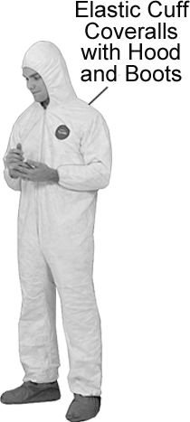
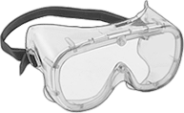
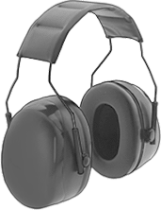
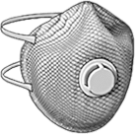
Examples of protective equipment
Dust Collector System
Disposable Tyvek Clothing
Fog Free Goggles to protect against airborne particles
Simple vinyl, disposable gloves found in most facilities are sufficient.
Disposable NIOSH
Approved respirators with exhale valve
Ear Protectors with sufficient Noise
Reduction Rating (NRR)

Slide 25
Final Preparation for for Patient fitting, after molding with Poly – Thermoforming Plastics
All Thermoforming plastics tend to be very user friendly and of the least hazardous to the shop environment, although the protective equipment on the previous slide are still recommended for different reasons.
The Poly materials can melt, spin off the product, and cause injury if high speed sanding equipment is used, thus high speed sanding equipment is NOT necessary and ill advised.
Noise, Dust, Eye and Skin irritants still exist. Caution is always recommended. As noted with regard to working with Composites, simple vinyl disposable gloves are more than sufficient. Most often nothing compares to the fine “hands – on” feel without the gloves used in other working environments. After all, we’re not changing engines in race cars here. Disposable vinyl gloves are inexpensive, and practical. Cleaning more expensive fabric gloves from excess adhesives is impractical.

Slide 26
Post Fitting Revisions, Adjustments ……..Within Reason……….
Laminations.
Unlimited adjustability.
Suffice to say that because the lamination is custom laid up by your choice of materials, and because the resins are conducive to self and re-adherence, an Orthosis can be heated, reshaped, repaired, and added-to; thusly changed in many ways without the sacrifice to structural integrity and only to the benefit of a more accurate fitting for the patient.
If previous and proper thought is given to the layup of materials used, a little extra trimming here and there should not sacrifice structural integrity.
Of course safety steps are recommended as noted in the previous slide.
Polypro.
Very limited adjustability.
Low level heating will allow minor reshaping of the plastic.
Significant trimming and re-trimming of excess plastic is directly dependent upon and will adversely effect the structural integrity of the appliance.
On the one hand the Poly materials are inexpensive, simple, and quick to work with, but on the other hand if a crack occurs, a misjudgment in trimlines or design, you had better hope you still have the positive mold because the product must be remade. There is no fixing, repairing, adding to, or redesigning ability here.

Slide 27
Final Delivery& Post Delivery Readjustments. Sudden Rx or Patient Preference Change Sudden Gait or Activity Change Did Orthotic Crack or Deform
What happens during Final Delivery of an Orthosis should hopefully, only be that of making sure all instructions are understood by the patient, that the Orthosis performs well and safely assists the patient in reaching his or her goal as prescribed by the Physician, intended by the Physical Therapist and manufactured by the ABC Certified Orthotist.
However .. In this field it is not uncommon that things just don’t always go as planned !!
The properties of the materials, be they Composite Thermosetting Laminations, or Thermoforming plastics of so many variations, are as similar in the final stags as they were in the beginning fitting stages of the orthosis.
Only so many adjustments can be done …. within reason …. with either material, although the custom designed composite lamination unquestionably offers more variability.
“If it aint broke, don’t fix it”, but if it is broke (incorrect) , or inadequate, or even questionable, get back to the bench and make the adjustments, or get out the positive cast/mold, dust it off, and remake the Orthosis (in the case of the Poly – Thermoforming plastic).

Slide 28
In Conclusion, questions to be asked:
Which material fits your shop ability?
Tools available ?
Safety comes first, but the right tool for the specific job is key, hence the choice, can you Fabricate the Orthosis in-house, or do you need to consider a Central – Fab Facility ?
Technician skills ?
Thermoforming plastics are quick – easy to learn – gross motor function skills to achieve.
Thermosetting plastics require an in depth knowledge of composite compatibility, resin properties, and force characteristics.
One, two, three or multi - employee operation ?
The smaller operation would tend to opt for the Poly – Thermoforming plastics, the larger operation has a choice.
Which does your patient need? See the following slides:

Slide 29
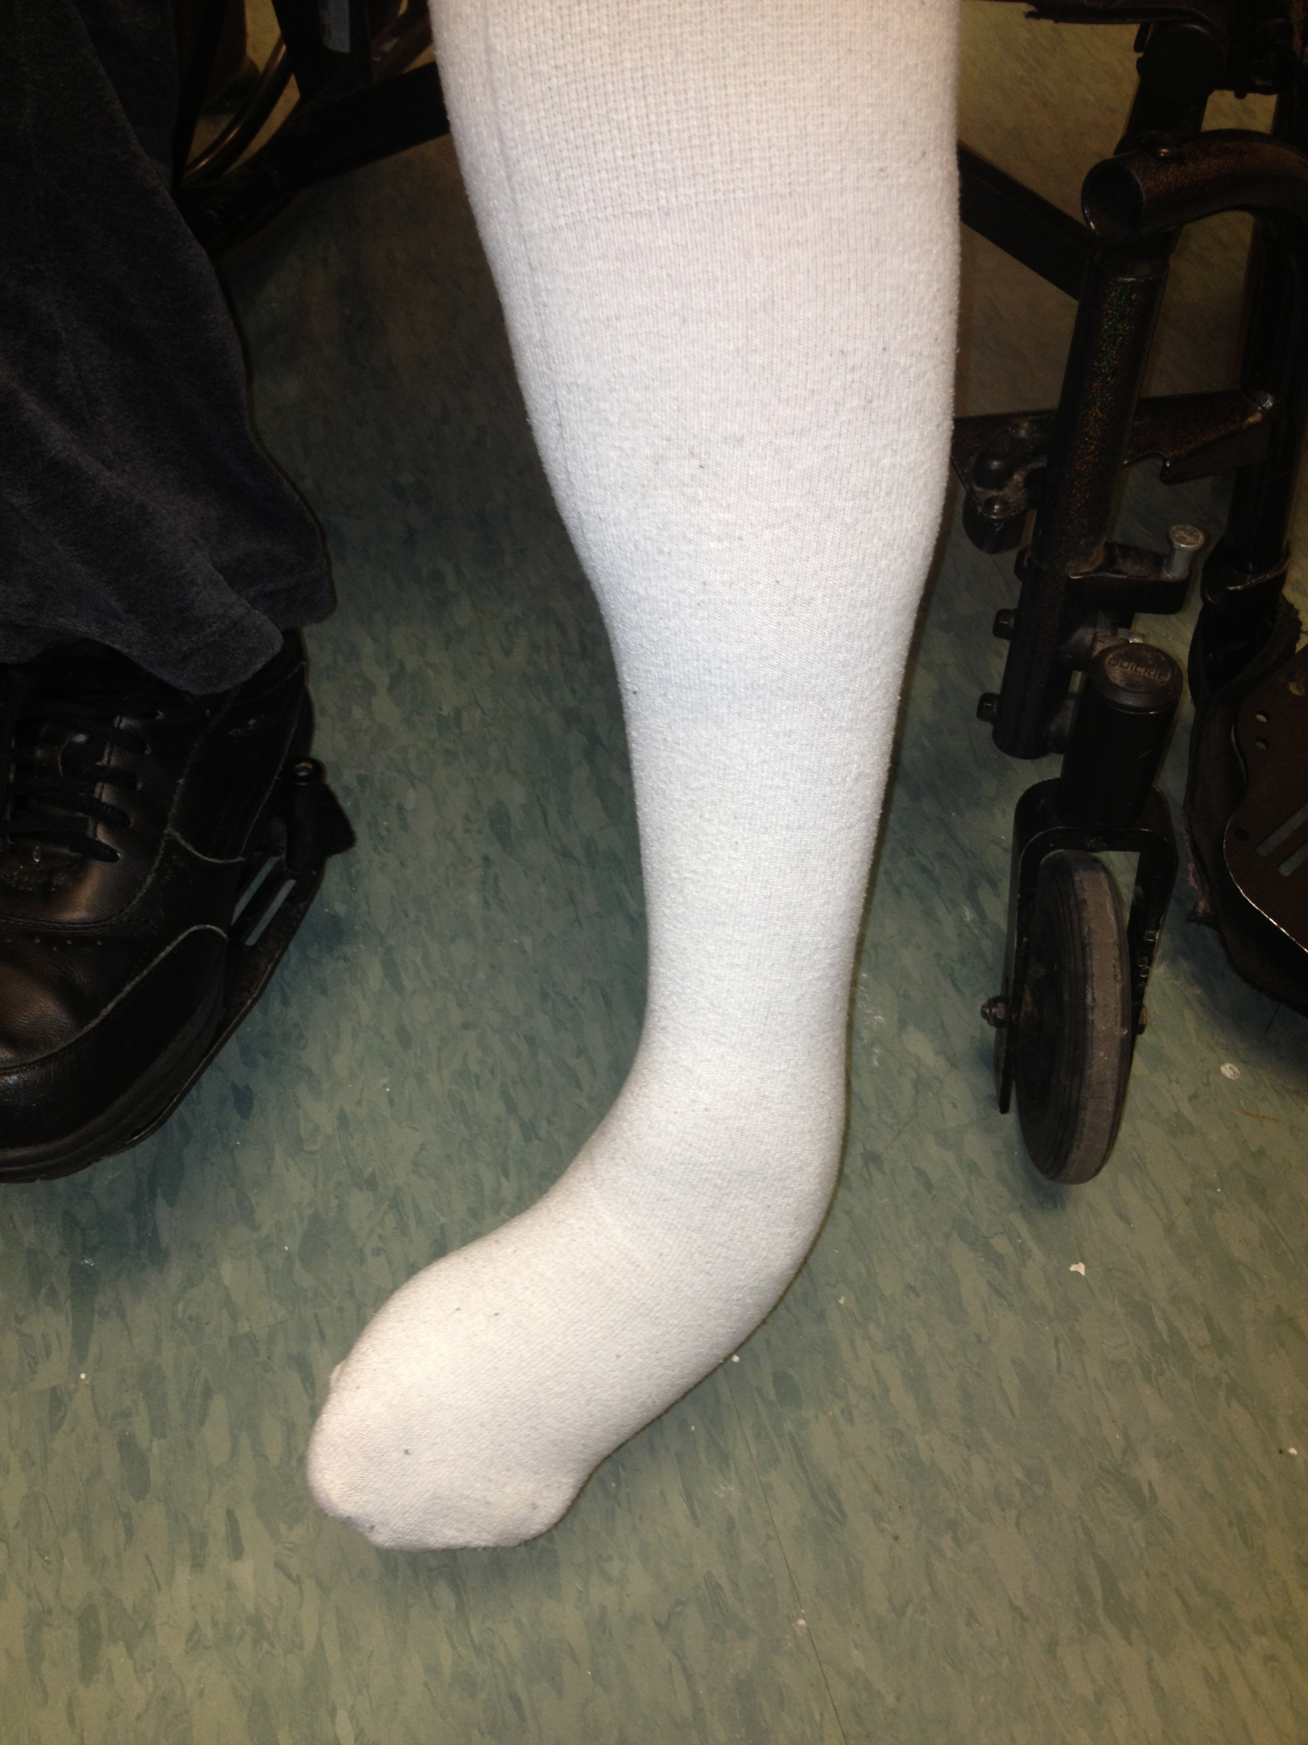
Conclusion – Patient Requirement example: The marriage of both materials
The following is just one example of a patient who would serve best with a Properly designed, Composite Laminated Orthosis, WITH a Polyethylene inner shell … and see the reason why …
This patient suffers from a severe equino-varus deformity with a high level of spasticity as well as an unpredictable sensory response causing extreme difficulty in donning and doffing as well as skin tolerance issues and compliance complications stemming from assistive Staff frustrations in servicing the patient.
Next Slide ……..

Slide 30
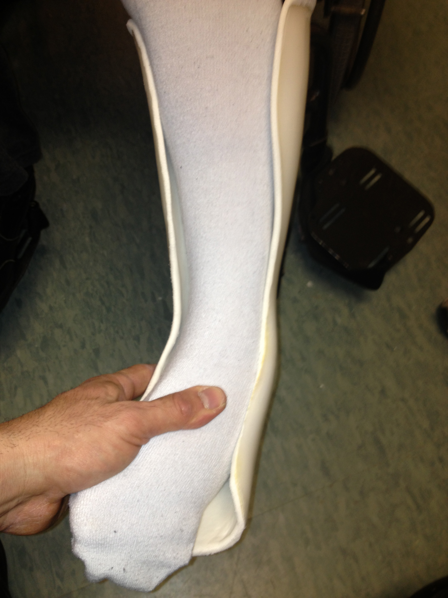
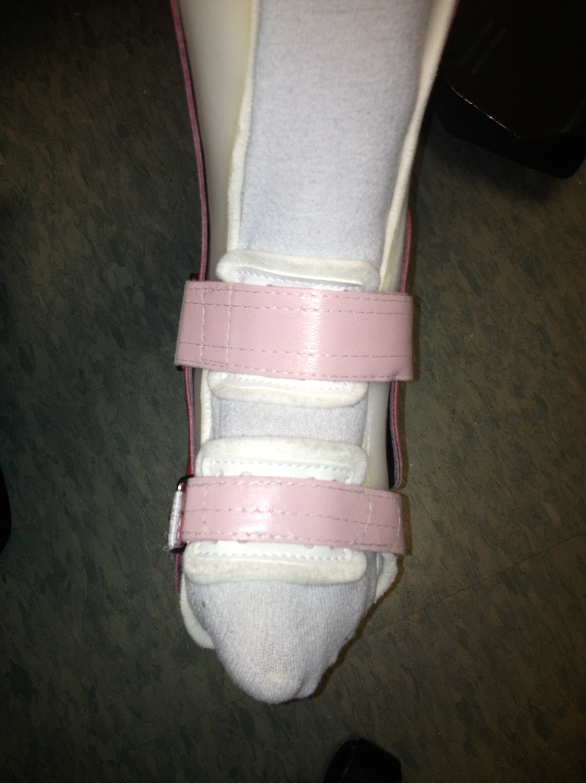
By utilizing a flexible inner Polyethylene liner to accomplish the first stage of donning, followed by a Composite Laminated outer shell to provide a means of gradual correction to maximum preferred alignment while maintaining structural integrity, this patient was able to wear an Orthosis that provided control, minimized staff frustrations, and ultimately patient compliance.
>>>
>>>

Slide 31
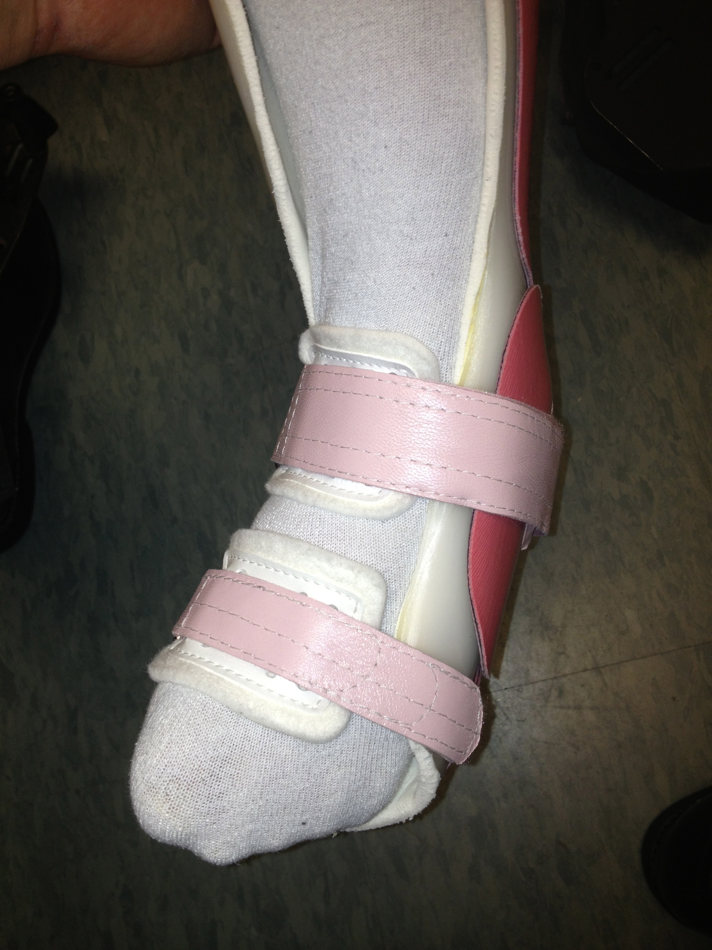
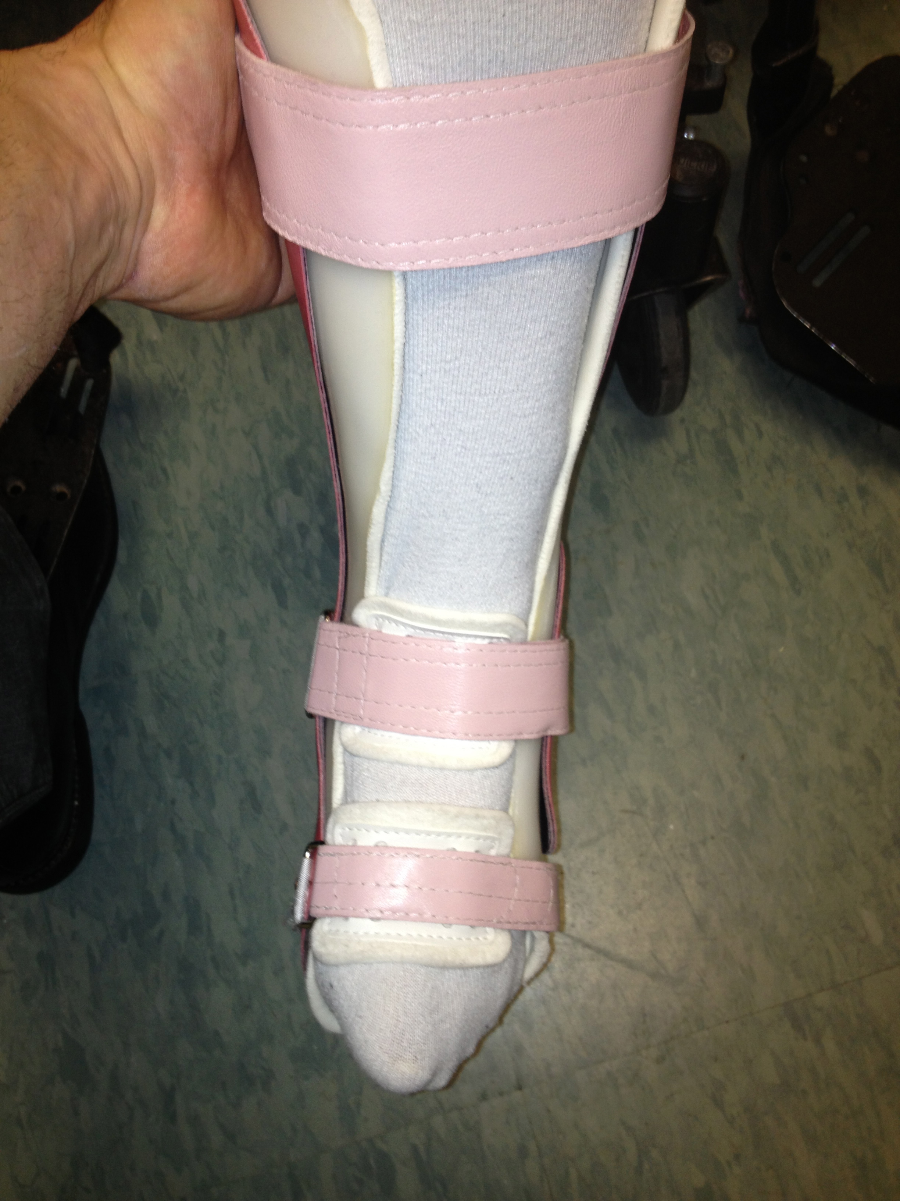
The Flexible inner Polyethylene liner allowed a 50% reduction in equino-varus with a manageable position, to then don the Composite Laminated outer shell utilizing a hinged door which is later closed to complete the process and achieve a maximally corrected position. Point being that the strategic layup of the composites allowed for the drastic trimming and design of the hinged door without sacrificing structural integrity; something most difficult to achieve with Thermoforming plastics.

Slide 32
Think your finished with this course? Click on the speaker below to find out:
Then go to the next slide …

Slide 33
So of course not ….
You need to go to:
www.BionicRehab.net, and go to the link at the bottom right that says: PowerPoint P&O Quiz – Plastics.
This is an 11 question interactive quiz that must be completed and will be automatically submitted to me upon which time I will issue a grade. The grade must be 80% or above to qualify for Category 1 Continuing Education Credits approved by The American Board for Certification in Orthotics, Prosthetics, & Pedorthotics.
If you have any questions, please call Andrew Cinque @ (914) 755 – 5145.
Oh no ….. One more thing as promised ….

Slide 34
Suggestions & Consultations
Prior to laminating or molding your Orthosis over a plaster positive cast, it is important to seal in moisture. Moisture can deteriorate the PVA bag of the lamination and ruin the process, as it can also create bubbles and poor vacuum during your Molding process (however it would be most advisable to consult with your plastics distributor regarding the specific thermoforming plastic you wish to use. I would recommend Cellulose Crystals, mixed with Acetone, available at Pel Supply Co., (800) 321 – 1264
For great prices, directly from the manufacturers, contact the following and do not be afraid to use my name as a recommendation:
Carbon or Fiberglass by the roll, flat sheet form, call Mary Schafer @ Fabric Development. (215) 536 – 1420 for more information.
Carbon, Fiberglass or Kevlar braid, by the roll, call A&P Technologies @ (513) 688 - 3200 for more information.
For Thermoforming Plastics of any kind, call AIN Plastics @ (877) 246 – 7700.
For the best savings of all, on Acrylic Modified Epoxy, directly from me ( a little story – my partner and I developed the formula and the AME name back in the 80’s), call me directly at: (914) 755 – 5145. In addition I will provide consultation on specific lay-up designs for Composite Laminations, or Central Fabrication services can be discussed.
Thanks for the time you took to take this course, and quiz. Your credits will follow once I receive the quiz and submit the grades to ABC. Good Luck in this ever changing world of healthcare, sincerely, Andrew A. Cinque CPO

